Slide 1
Improving Student Writing in the STEM Disciplines
A Faculty Learning Community
Workshop Two

Slide 2
Website
stemflc.digitalodu.com

Slide 3
Upload to Google Drive Folder
Syllabus
Project Description
Student Samples (all)

Slide 4
Student Learning Outcomes (QEP)
Students will be able to:
Clearly state a focused problem, question, or topic appropriate for the purpose of the task;
Identify relevant knowledge and credible sources;
Synthesize information and multiple viewpoints related to the problem, question, or topic;
Apply appropriate research methods or theoretical framework to the problem, question, or topic;
Formulate conclusions that are logically tied to inquiry findings and consider applications; limitations, and implications, and
Reflect on or evaluate what was learned.
Notes:
Direct them to the handoout. Note that it will be referenced throughout.

Slide 5
Questions Explored Today
What makes for a good writing assignment?
How can we communicate expectations to students in a clear way?
What activities can be done to contribute to the completion of a successful writing project?
How do we differ by discipline?
Notes:
Workshop 3 will cover assessment (although one eye should be directed at that at the beginning).

Slide 6
Workshop Modules
Conceptualizing Writing (Dan)
Genres and Scaffolding (Julia)
Scaffolding and Collaboration (Pilar)
Peer Review (Megan)
Assignment Prompt Revision (Vukica)

Slide 7
Module 1: Conceptualizing Writing

Slide 8
Concept Building: Visualizations
Map, model, and/or visualize the process of:
Workplace Writing
Think perhaps in terms of genre, purpose, technology, audience, formatting, and relationships.

Slide 9
Concept Building: Visualizations
Map, model, and/or visualize the process of:
Writing in Your Classroom
Think perhaps in terms of assignments, objectives, projects, and outcomes.

Slide 10
Three Views of Communication
Transmission
Translation
Articulation
Sender
Sender
Sender
Receiver
Message
Receiver
Receiver

Slide 11
Three Views of Communication
Transmission
Communication is the transportation of messages.
Measurable entity transmitted from one point to another by means of a clearly delineated channel.
Power: sender > receiver
Translation
Meaning produced through the interaction of sender and receiver
Communication is a practice
Presence of a receiver adds meaning to communication
Power: negotiated
Articulation
Communication and meaning placed in social context of power
Connections of elements (sender, receiver, tech) are specific and particular to the situation, ongoing and reciprocal
Power: contingent and constructed

Slide 12
Visualizing: Transmission
Content
Writing

Slide 13
Visualizing: Translation/Articulation
Content
Writing

Slide 14
Next Level: Metaphors
“We act according to the way we conceive of things.”
-Lakoff and Johnson, 1990.

Slide 15
Metaphors of Argumentation
 | War | Dance
Goal | Victory | Co-operation
Student | Soldier | Partner
Writing | Weaponry | Technique, Responsiveness

Slide 16
Module 1 Activity
Write a Statement of Writing that could be included on your syllabus that reflects your conceptualization of writing.

Slide 17
Example
In a field of Mechanical Engineering Technology, technical writing is very important part of engineering communication on a daily basis in any kind of engineering job. Most of the design and manufacturing work is done in companies which work with their suppliers and customers who are very often at different locations. Hence, communicating precisely design requirements and important decisions is very important for any kind of engineering work. In addition, students in our major need to complete Senior Design project in which they design and build some device. As a result of this effort, the final output is the technical report. Hence, knowing how to explain your ideas would benefit your future endeavors, not only while at ODU, but in your future career. For that purpose, one of the basic requirements in this class would be various writing assignments (scaffolding writing format to support content learning) as a homework, midterm project proposal (technical report) and a final project report (also in a form of a technical report).

Slide 18
Module 2: Genres and Scaffolding

Slide 19
Module 2: Scaffolding & Genre
Good writing assignment design relies upon several components:
Scaffolding
Genre expectations
Peer review processes
Assessment

Slide 20
Terministic Screens
Even if any given terminology is a reflection of reality, by its very nature as a terminology it must be a selection of reality; and to this extent must function also as a deflection of reality.” (Burke, Language as Symbolic Action, 1966, p. 45)

Slide 21
Writing to Learn
Writing can be used to assist students in grasping new concepts. The act of articulating ideas in their own words requires deeper understanding than mere memorization.
We know that when students are writing about a new concept, their grammatical skills decline as they struggle to articulate new concepts. Revision is difficult if they have no good conceptualization of what they are doing. (Flower, et al, 1986)

Slide 22
Scaffolding
Scaffolding allows students to build on known concepts to master new concepts.
Scaffolding works well when small low stakes assignments move into high stakes graded assignments.
Students learning new concepts do better with summarizing (articulating in their own words to improve comprehension) before analysis.
Providing evidence to support claims requires comprehension of concepts. (McCarthy, 1987)

Slide 23
Genre
A genre is a document classification based on features like:
Purpose
Audience type(s) & disciplinary experience
Tone
Pattern of Organization
Types of Evidence
Formatting conventions
These arise out of a communicative need and become codified through audience expectations. (Miller, 1984)

Slide 24
Disciplinary Genres
What types of documents do you have your students write?
What are their features?
Purpose
Audience type(s) & disciplinary experience
Tone
Pattern of Organization
Types of Evidence
Formatting conventions

Slide 25
Module 2 Exercise Part 1
Exchange assignments with someone not in your discipline.
Identify each term from your peer’s prompt that you recognize (or don’t recognize) as being disciplinary specific (a terministic screen).
Role-play being a second-year student using this prompt, what questions would you have of your peer?

Slide 26
Module 2 Exercise Part 2
Based upon the role-playing, spend 5 minutes writing up how you would approach writing this assignment prompt if it were yours. Think about the following:
How would you approach writing the prompt? Why?
What is missing? What is there that really works?
What were you missing that you hoped to see?
Share the revisions with the original author. Discuss what was changed and the rationales for the changes.

Slide 27
Module 2 Exercise part 1
Construct your scaffolding:
Brainstorm low-stakes activities that help students write about/work with:
Purpose
Audience type(s) & disciplinary experience
Tone
Pattern of Organization
Types of Evidence
Formatting conventions

Slide 28
Module 2 Exercise part 2
Revise your assignment prompt:
Add a brief explanation of the following elements
Purpose
Audience type(s) & disciplinary experience
Tone
Pattern of Organization
Types of Evidence
Formatting conventions

Slide 29
Module 2 Exercise Reflection
Take a few minutes to compare your assignment revision and your scaffolding to the SLOs.
Will students fulfill the SLOs in your assignment?
Will students fulfill at least one SLO in the scaffolding activity?
Is there an opportunity to fulfill SLOs for a given assignment across a series of low-stakes activities that work toward a high-stakes assignment?

Slide 30
Module 2: Summation
Writing is an ongoing process of negotiated meaning between writer and audience.
Success in writing depends upon the writer understanding their purpose, their audience’s needs, and expectations regarding genre and language conventions.

Slide 31
Module 3: Setting the Stage for Collaborative Writing Assignments

Slide 32
Setting the stage for collaborative writing
Problems in collaborative writing-intensive projects
Setting the stage and context for successful collaborative writing.
Mutual accountability and appropriate flow and integration of content
Individual vs collective outcomes.

Slide 33
Benefits of Collaboration
•Collaborative skills are expected in the workplace
•Preparing students for capstone projects
•Collaboration provides opportunities for students to discuss a variety of viewpoints and perspectives, negotiate meanings and solutions, and delegate responsibilities in order to more effectively solve complex, ill-structured problems (Grabinger, 1996).

Slide 34
Collaborative Learning Poll
Have you or do you currently use collaborative learning/writing in any of your courses?

Slide 35
Your Thoughts
Let’s say you just formed groups of students in your class and gave them a high-stakes group writing-intensive assignment.
What can go wrong?

Slide 36
Possible Outcomes
•Lack of integration of materials
•Free riding
•Team Conflict
•Unfair assignment of grades
•Negative experience and unwillingness to work in teams
•Faculty---> Counselor

Slide 37
Need for procedural scaffolds
Students should not be expected to work together effectively without proper training and experience in cooperative and collaborative
skills (Johnson & Johnson, 1991).

Slide 38
Scaffolding? What do I mean?
Scaffolds are tools, strategies, and guides used during learning to enable students to develop understandings beyond their immediate grasp (Graesser et al., 2000; Reiser, 2002).
GOALS:
•Channeling and focusing students
•Modeling outcomes

Slide 39
Scaffolding the collaborative writing process
What structures and processes can we put in place in the course as part of the collaborative assignments to insure student learning and success?

Slide 40
Some strategies to enhance learning
•Clarify expectations (process and outcome)
•Model the process: Establish positive inter- dependence and Individual/Mutual accountability
•Group goals and rewards
•Methods for providing students with opportunities to learn and practice group collaborative skills
(Brush, 1998; Johnson & Johnson, 1991; Slavin, 1995)

Slide 41
Clarify expectations and model the process activity
What kind of information would you add to your assignment to clarify expectations with regards to a collaborative writing assignment? Please list those individually.
How can you model the collaborative writing process to help avoid some of the common pitfalls? Create a second list individually.

Slide 42
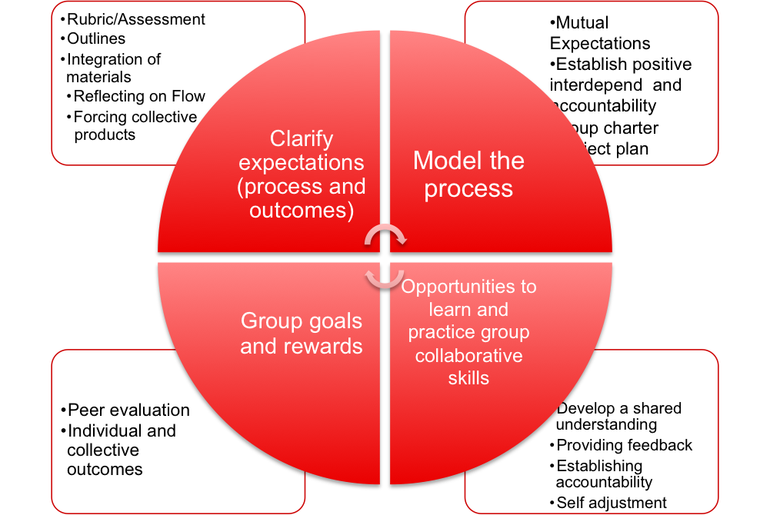
Some Elements of Scaffolding

Slide 43
Clarify Course Expectations and Model the Process
•Rubric/Assessment
•Outlines
•Integration of materials
•Reflecting on audience, flow, overall message
•Forcing collective products (divided analysis and common problem identification)
•Peer feedback
•Key resources

Slide 44
Procedural Scaffolds: Model the Process
Clarify mutual expectations and goals
•Template project charter
•Template project plan
https://sites.google.com/a/odu.edu/enma601_fall14_team10/issues
https://sites.google.com/a/odu.edu/enma601_team1/home

Slide 45
Assessment
•Peer evaluation (Midterm / Final) that accounts for the total grade
•Justify assessment with specific facts
•Individual and collective outcomes associated with individual and collective rewards.

Slide 46
Developing Collaborative Writing Skills
•Develop a shared understanding (adapt to the context)
•Provide feedback
•Establish individual and shared accountability
•Self adjustment

Slide 47
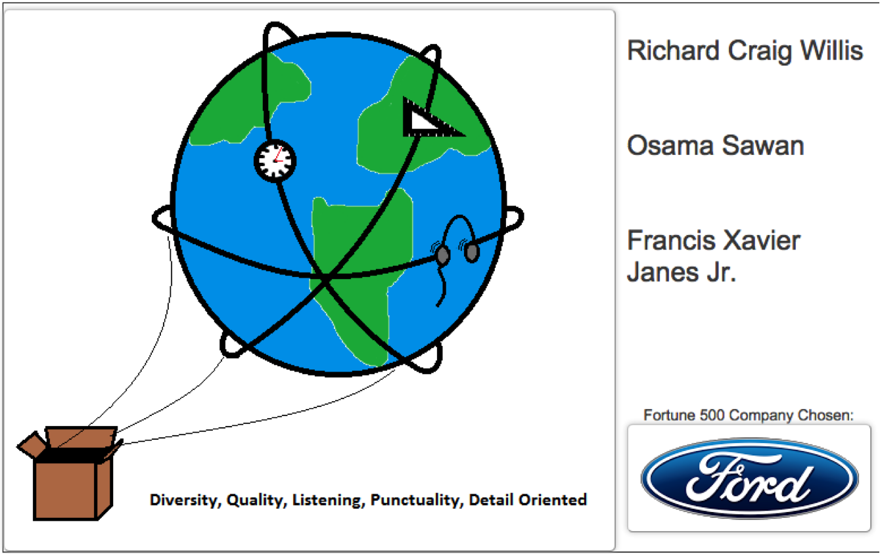

Slide 48
Developing Collaborative Skills
•Develop a shared understanding
•Providing feedback
•Establishing accountability
•Self adjustment

Slide 49
Metacognitive Scaffolds
Short reflection essays
Midterm update and self-evaluation
Proposal

Slide 50
Types of Scaffolds
Conceptual: concepts and information to consider in the final deliverable
Procedural: modeling the collaborative writing process and using the tools
Metacognitive: reflect on the activities
Strategic: Identifying alternative solutions

Slide 51
Final Reflection
Now that we know some common features of good collaborative writing assignments, which ones are disciplinarily specific?

Slide 52
Module 4: Peer Review

Slide 53
Module 4: Peer Review Goals
Do you require students to conduct a peer review?
What should students look for, comment on, analyze/address when doing a peer review?
How do you train students to see what you see, to say what you might say?

Slide 54
Good Peer Review
Review helps writers learn their strengths, correct problems in the message or goal, and improve their processes.

Slide 55
Feedback Styles
Reviewer rewrites. (You want your students to be coaches not grammar police.)
Reviewer makes vague comments. (Students need guidelines to follow and guide their comments.)
Reviewer writes comments and discusses with author. (This offers the best learning opportunity.)

Slide 56
Feedback Techniques
Teaching a student how to write means teaching a student how to rewrite.
Breadth: Students should practice many methods to be able to effectively select the right revision process for the right project.
Transfer: Support peer review techniques by adopting them into your instructor feedback methods. Students will adopt them, too.

Slide 57
Practicing Feedback
Get out the draft of your Assignment Prompt.
Read a section of your prompt aloud to the group.
As a group, perform at least 1 of the techniques detailed on the Peer Feedback Techniques Handout.
Share results
How do these techniques support SLOs?

Slide 58
Adding to the Prompt
Draft a list of writing assignment grading criteria or draw from your genre features.
Develop peer review guidelines for your assignment prompt.
Select at least 1 peer feedback technique that might support a peer review for this assignment.

Slide 59
Prompt Feedback
Exchange assignment prompt, criteria list, and peer review prompt (with feedback technique) with someone outside your discipline.
Answer the following for your FLC partner:
How does/should your partner’s peer review design help students give assignment-specific feedback?
How does/should it support the students’ ability to fulfill the SLO’s?
Notes:
Report out on the final question.

Slide 60
Peer Review Prompts
Should directly reference the language of the assignment.
Should directly reference the genre expectations for the assignment.
These should also operate as the primary criteria for grading.
Does yours? Take a moment to note any further need for change.

Slide 61
Module 5: Assignment Techniques

Slide 62
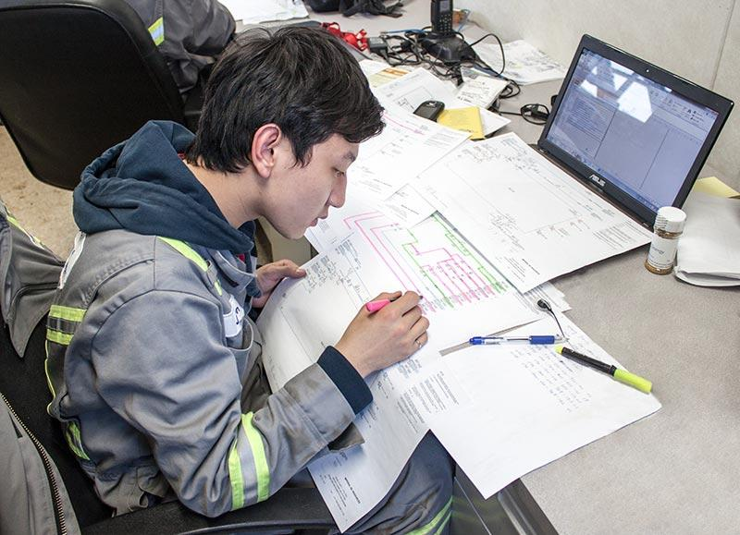
STEM Workplace
Notes:
http://osep.northwestern.edu/sites/default/files/PD/2012.06.27-28/Types%20of%20Writing%20Assignments%20handout.pdf

Slide 63
STEM-Related Assignment Techniques
Freewriting
Learning Logs
Summaries and Paraphrases
Explanations
Definitions
Formal Research Essay
Notes:
http://osep.northwestern.edu/sites/default/files/PD/2012.06.27-28/Types%20of%20Writing%20Assignments%20handout.pdf

Slide 64
Freewriting
Freewriting is the practice of writing non-­‐stop for a set period of time in response to a prompt or question.
This exercise allows the students to explore their own creativity on a topic without the necessity (or even possibility) of supporting their thoughts with evidence or resources.
Freewriting is especially effective at getting students prepared to discuss a particular topic; as such, prompts related to the day’s lesson are best.
With the focus on creativity, use prompts that focus on application of concepts instead of calculations or lab results.

Slide 65
Freewriting - Grading
Freewriting does not need to be graded at all, especially if used for discussion.
It can be collected and graded, but only grade on completion, not on quality.
The goal is to get the students comfortable with writing their thoughts and ideas.

Slide 66
Learning Logs
Learning logs are a broader version of the chemistry lab report. As students carry out experiments, calculations, or observations, assign a paragraph or two that will allow them to explain what the experiment means or how the observation results can be used in another context. This is the qualitative counterpart to the quantitative portion of their study; as such, encourage the students to avoid numbers whenever possible. As they focus on the nature of the concept rather than the amount of a substance, they will understand it differently. Learning logs can be graded as a small part of the homework; 10-­‐15% will tend to help the students take them seriously. When grading, focus on the use of key words and appropriate applications; do not check for any lower-­‐level concerns (spelling, punctuation, grammar, etc.). Brevity is important; restrict them to two paragraphs and half a page.

Slide 67
Summaries and Paraphrases
When confronted with a challenging portion of reading material, writing a summary or paraphrase can help students put the concepts in their own language, using metaphors and figures of speech that are meaningful and memorable to them. A paraphrase is a written assignment of approximately the same length as the original text; a summary is significantly shorter. Summaries are more common and more useful: the process of condensing the material also forces students to decide what the concepts mean and how they relate to one another. These should be assigned sparingly. They tend to be tedious to students, and they take more time to grade since the content needs to be monitored. Used properly, though, summaries and paraphrases can be powerful writing tools.

Slide 68
Explanations
Applications of scientific principles are important illustrations, and they are very helpful in showing students how science influences our lives. Explaining a process or application can help cement it in the students’ minds, and accurate written explanations provide some of the best evidence we have that our students understand the principles and concepts. Written explanations are more deliberate versions of “How does it work” questions in class discussion; ask students to write 2-­‐3 paragraph descriptions of chemical changes or energy production. Writing will help them follow through the details specifically. As with learning logs, grade these as participation, if at all. Check for key words, but do not correct lower-­‐ level mistakes.

Slide 69
Definitions
When encountering a new, difficult concept, building definitions can help students understand the relationship of the principle with others they are more familiar with. The simplest way to have students build definitions is with a two-­‐step process: 1) place the item in a category; 2) differentiate the item from the other things in the category. To take an extremely simple example: A boy is a person (category) who is not a girl (differentiation). It can also be useful to combine terms and have students define them as a pair of related concepts. Example: What is the relationship between chlorophyll and photosynthesis?

Slide 70
Formal Research Essay
Two or three times per year, it may be appropriate to assign a longer, more developed essay.
Have your students start with a research question in the field:
Should Commonwealth of Virginia require every high school student to take physics?
Why was the Tevatron defunded, and should we revisit that decision?
How can Americans be convinced to more consistently choose clean energy?

Slide 71
Formal Research Essay
Research Questions
The research questions should require investigation into scientific concepts that were not fully covered in class, and they should push the students to apply the science to social, cultural, or governmental situations. These essays are also opportunities to teach students about trustworthy sources; as they find books, articles, and websites, discuss with them how their various sources can be used. Encourage your students to make an argument in this essay. As they come to see the place of rhetoric in science, they will understand that it is not simply black and white: there are multiple perspectives that must be negotiated, especially in the ways science will be used. These essays need to be graded with more care than the others, but you should still not feel pressure to be grammar police. Focus on the higher-­‐level concerns: accuracy of the scientific information, persuasiveness of the argument, reliability of the sources, etc.

Slide 72
Student Learning Outcomes (SLOs)
Students will be able to:
Clearly state a focused problem, question, or topic appropriate for the purpose of the task
Identify relevant knowledge and credible sources
Synthesize information and multiple viewpoints related to the problem, question, or topic
Apply appropriate research methods or theoretical framework to the problem, question, or topic
Formulate conclusions that are logically tied to inquiry findings and
consider applications, limitations, and implications, and
Reflect on or evaluate what was learned.

Slide 73
Writing Example 1:
Choose one of the applications of mechatronics/embedded systems in automotive applications and explain how it works:
• Entertainment
• Generation II ABS
• Heads-up monitoring
• Night vision
• Back-up collision sensor
• Navigation
• Tire pressure sensing
• Spark timing
• Holonomic non-holonomic motion
• Adaptive control
• Tele-operation
• Rain-sensing
• Auto parking
• Simulators
• Testing
• Active suspension
Upload file here or turn it in in paper to professor before the class on Thursday or by 5 pm on Friday in professor's mailbox.
Format: one page single space or two pages double space. Please use appropriate referencing for resources that you used.
Some links: How the stuff works - Auto http://auto.howstuffworks.com/

Slide 74
Writing Example 1 - Revised:
Choose one of the applications of mechatronics/embedded systems in automotive applications and explain how it works:
• Entertainment
• Generation II ABS
• Heads-up monitoring
• Night vision
• Back-up collision sensor
• Navigation
• Tire pressure sensing
• Spark timing
• Holonomic non-holonomic motion
• Adaptive control
• Tele-operation
• Rain-sensing
• Auto parking
• Simulators
• Testing
• Active suspension

Slide 75
Writing Example 1 - Revised:
Upload file here or turn it in in paper to professor before the class on Thursday.
Format: one page single space or two pages double space. Please use appropriate referencing for resources that you used.
· APA Referencing style: https://owl.english.purdue.edu/owl/resource/560/01/
· EndNote software: http://www.lib.odu.edu/genedinfolit/6citing/endnote.html
· http://www.odu.edu/ts/software-services/endnote
· Install EndNote: http://guides.lib.odu.edu/installendnote
· References - sample paper attached (APA citations).
· o How the stuff works - Auto http://auto.howstuffworks.com/
o Continental Automotive http://www.conti-online.com/www/download/automotive_de_en/general/download/daten_fakten_pt_en.pdf

Slide 76
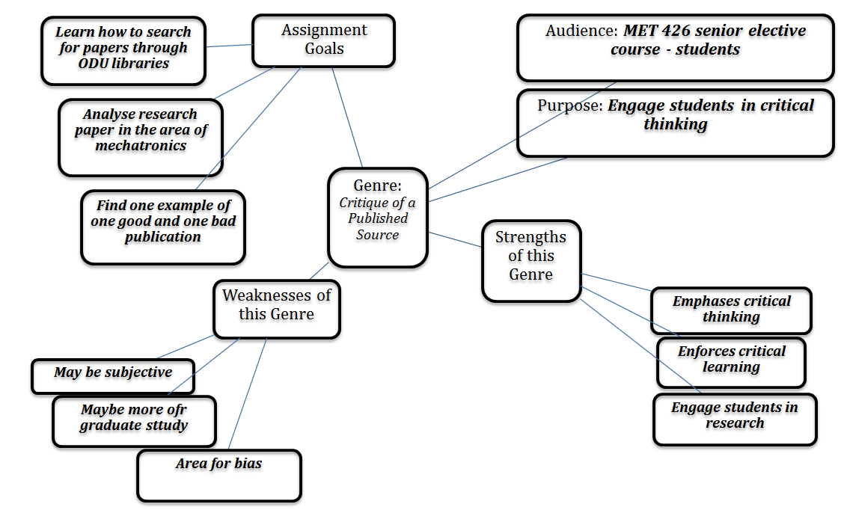
Imagining a New Genre

Slide 77
Final Reflection
What makes for a good writing assignment?
How can we communicate expectations to students in a clear way?
What activities can be done to contribute to the completion of a successful writing project?
How do we differ by discipline?
Notes:
What did you see rise ot the surface?

